Slide 1
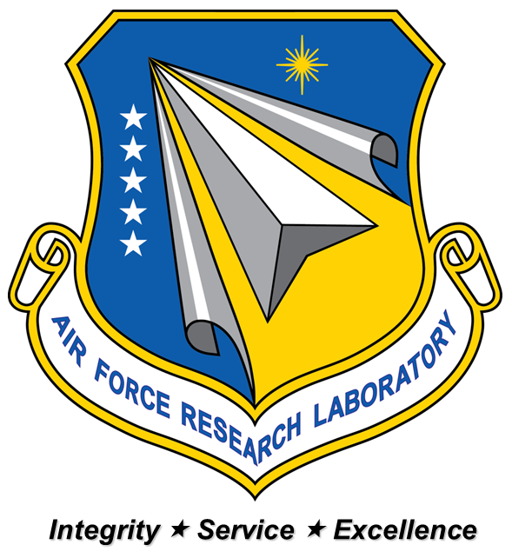
Penetration Resolution in Computer Modeled Fabrics
Collin Blake
Contractor
AFRL/RXCC
Dr. John Whitcomb 1, Dr. Craig Przybyla 2
1. Texas A&M University 2. Air Force Research Lab

Slide 2
Outline
Background
Textile Simulation
Problem
Initial ideas
Issues Encountered
Current Resolution
Issues Encountered
Current Issues
Future Plans

Slide 3
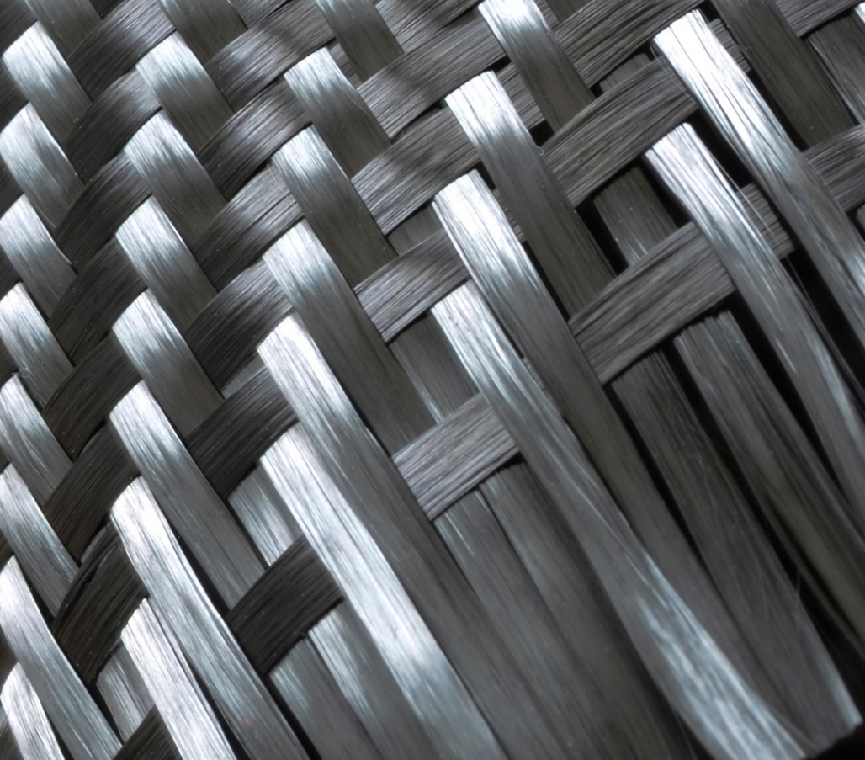
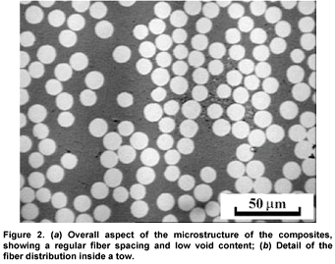
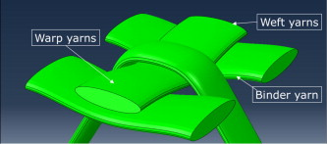
Background
Evolution of composite materials lead into computational analysis and design of fiber-reinforced structures
Current focus of these materials is understanding and simulating damage initiation and propagation
Extensive research at microstructure level
Mesoscale next level

Slide 4
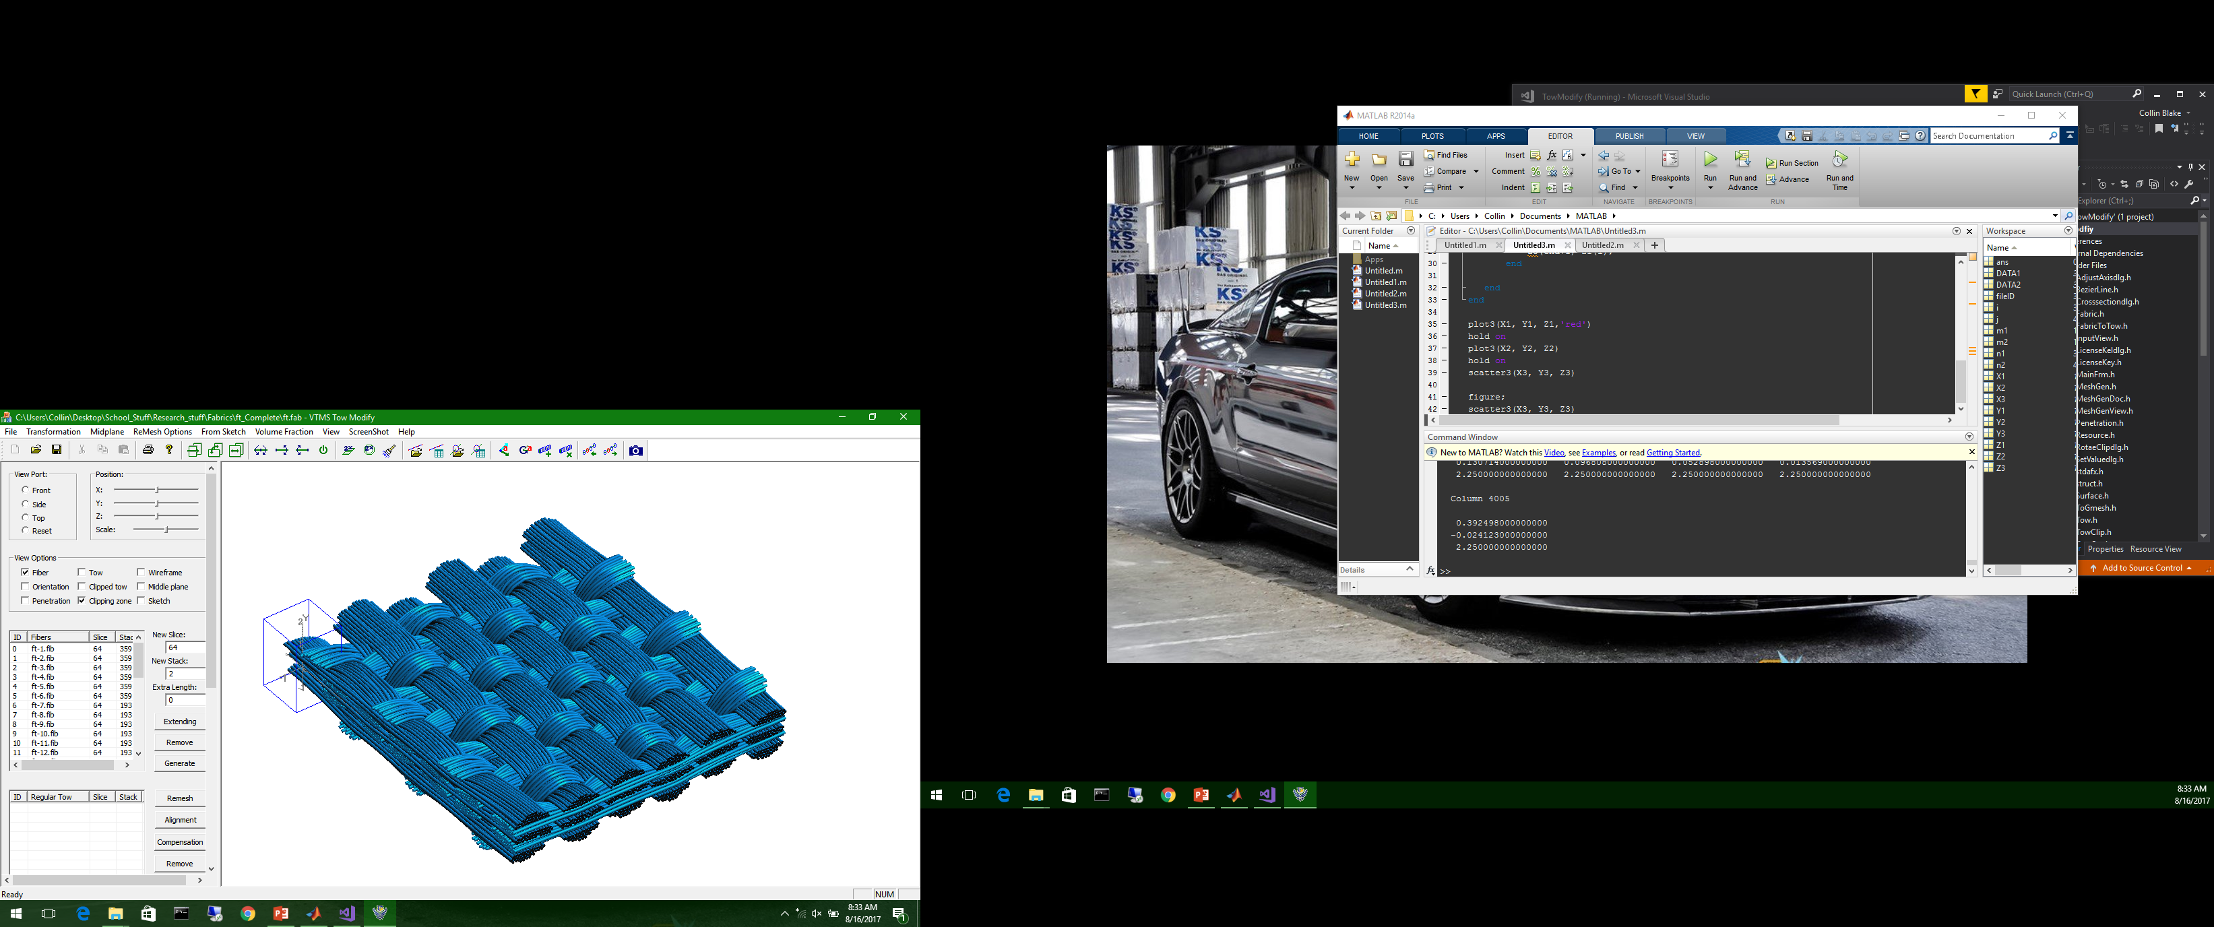
Background
Evolving modelling techniques and computational ability allow us to model increasingly complex geometries for computer analysis
Modelling discrete fibers very computationally expensive
Using Homogenized Tows with matrix surrounding tows

Slide 5
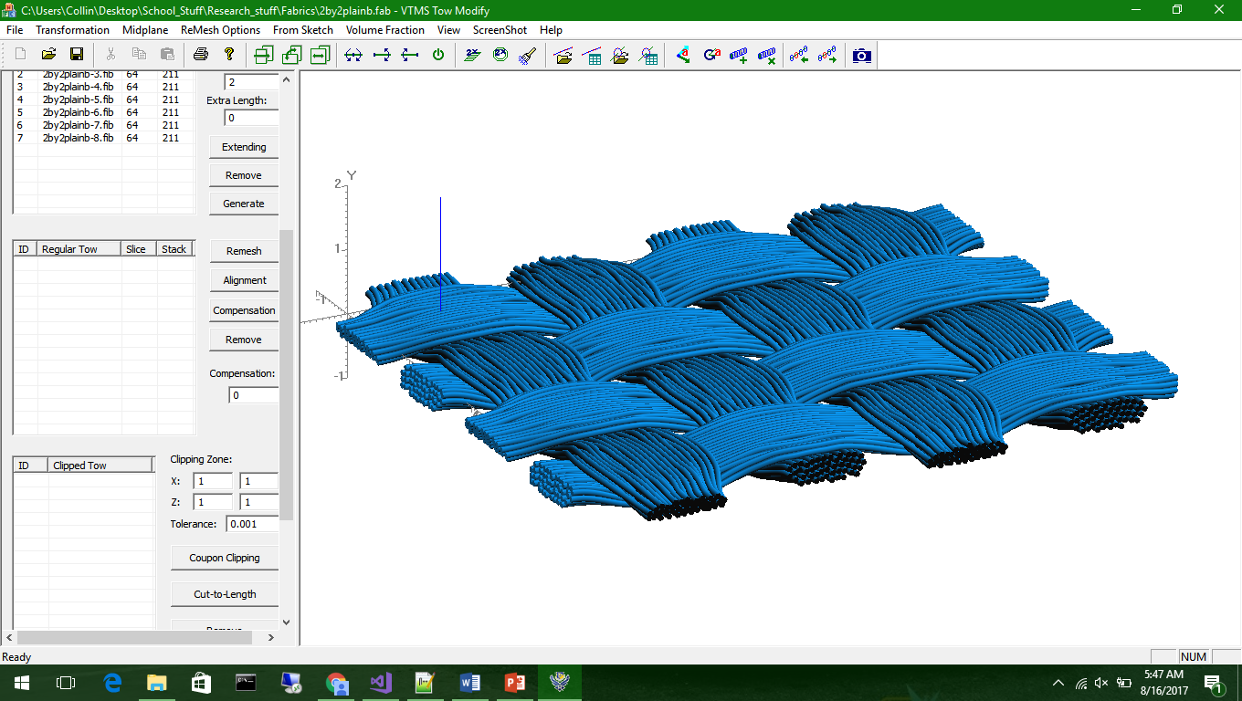
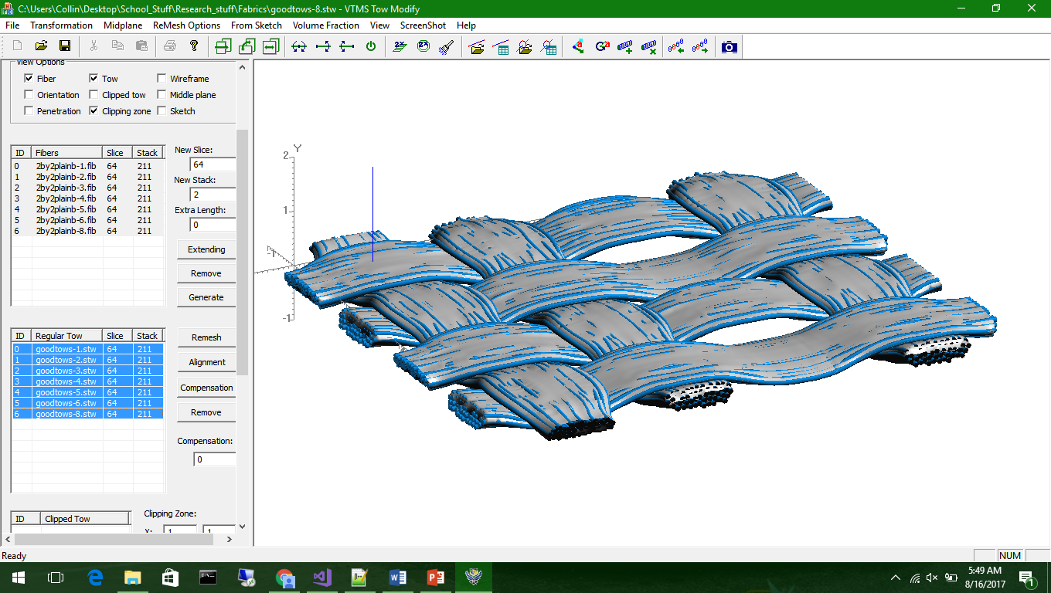
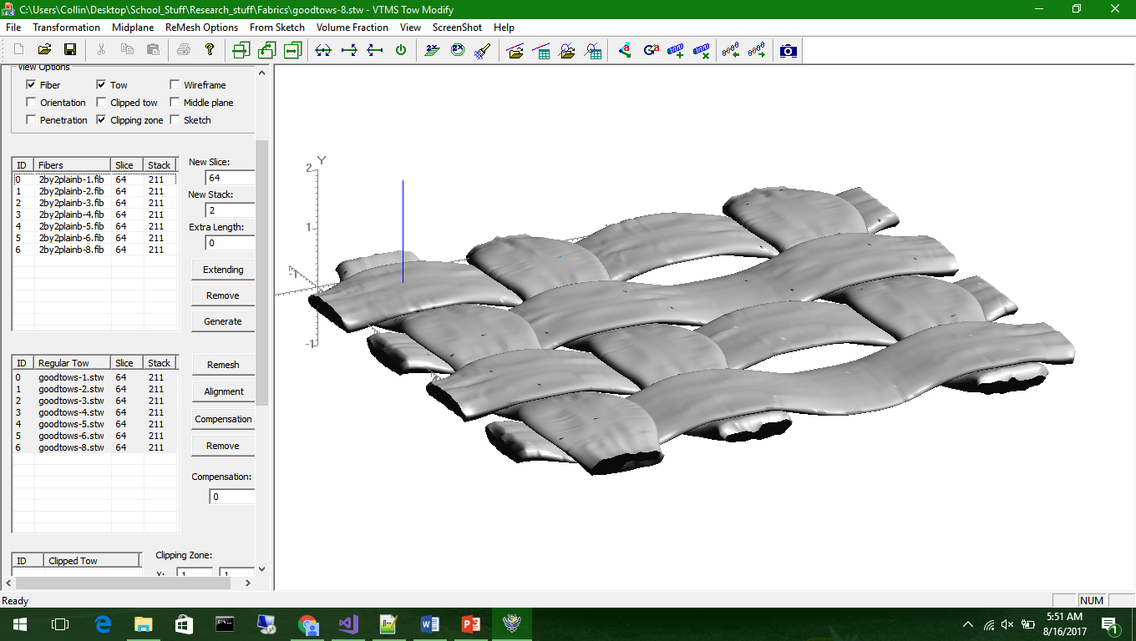
Textile Simulation
Digital chain method to generate realistic woven geometry
Discrete fiber filaments can then be converted into homogenized tows and modelled in a matrix
Creates realistic woven geometries that can be analyzed

Slide 6
Penetration
Created geometries come with penetrating surfaces
Tows in close proximity develop surface penetrations after tow surface creation
Detecting Penetrations secondary problem
Conventional FEA programs cannot run analysis

Slide 7
Initial Idea
In order to impose surface to surface contact, a plane is placed between the penetrating surfaces.
The penetrating nodes are then moved to this surface
This will ideally create a perfect contact surface between the tows

Slide 8
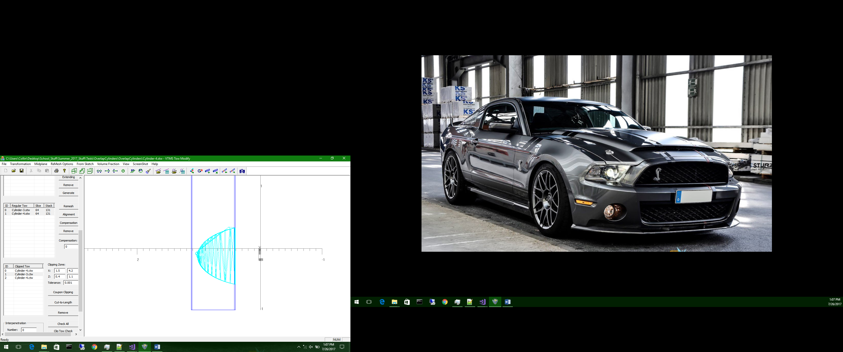
Issues Encountered
Creates “Spurs” near penetration boundary
Does not account for large curvatures
Can create too large of surface, significantly altering tow topography
Matrix pockets can also occur

Slide 9
Next Ideas
Use NURBS Surface to define penetrating surfaces
Gives analytical solution
Defines Penetration surface boundary
Reduces tow volumes during fitting
Can be difficult to redefine tow mesh along boundary
Polyhedron Penetration Detection
Used in video game physics
Difficult to determine penetration distance
Used primarily as avoidance, not resolution (time dependent
Least Square Bivariate Cubic Fit Surface
Difficult to implement
Better fitted surface of actual tow geometry

Slide 10
Current Solution
Find nearest neighbor of penetrating node on tow being penetrated
Compute half distance and move both nodes to location
Resolves compatibility

Slide 11
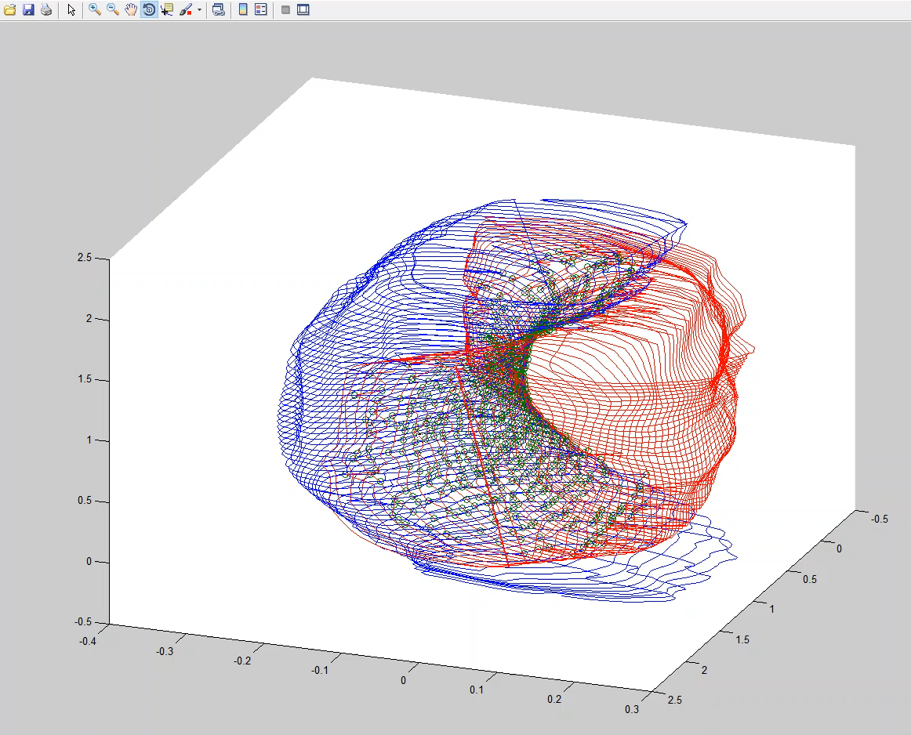
Current Solution (cont’d)

Slide 12
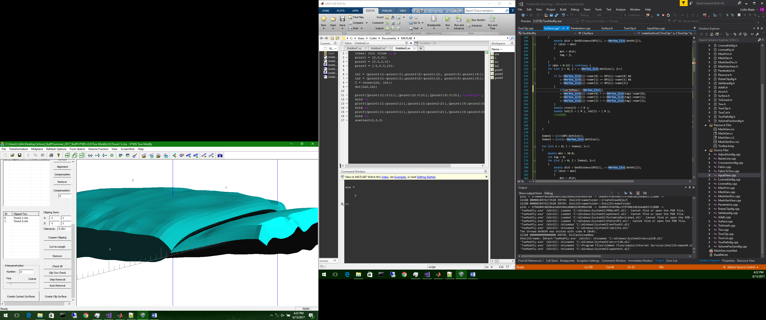
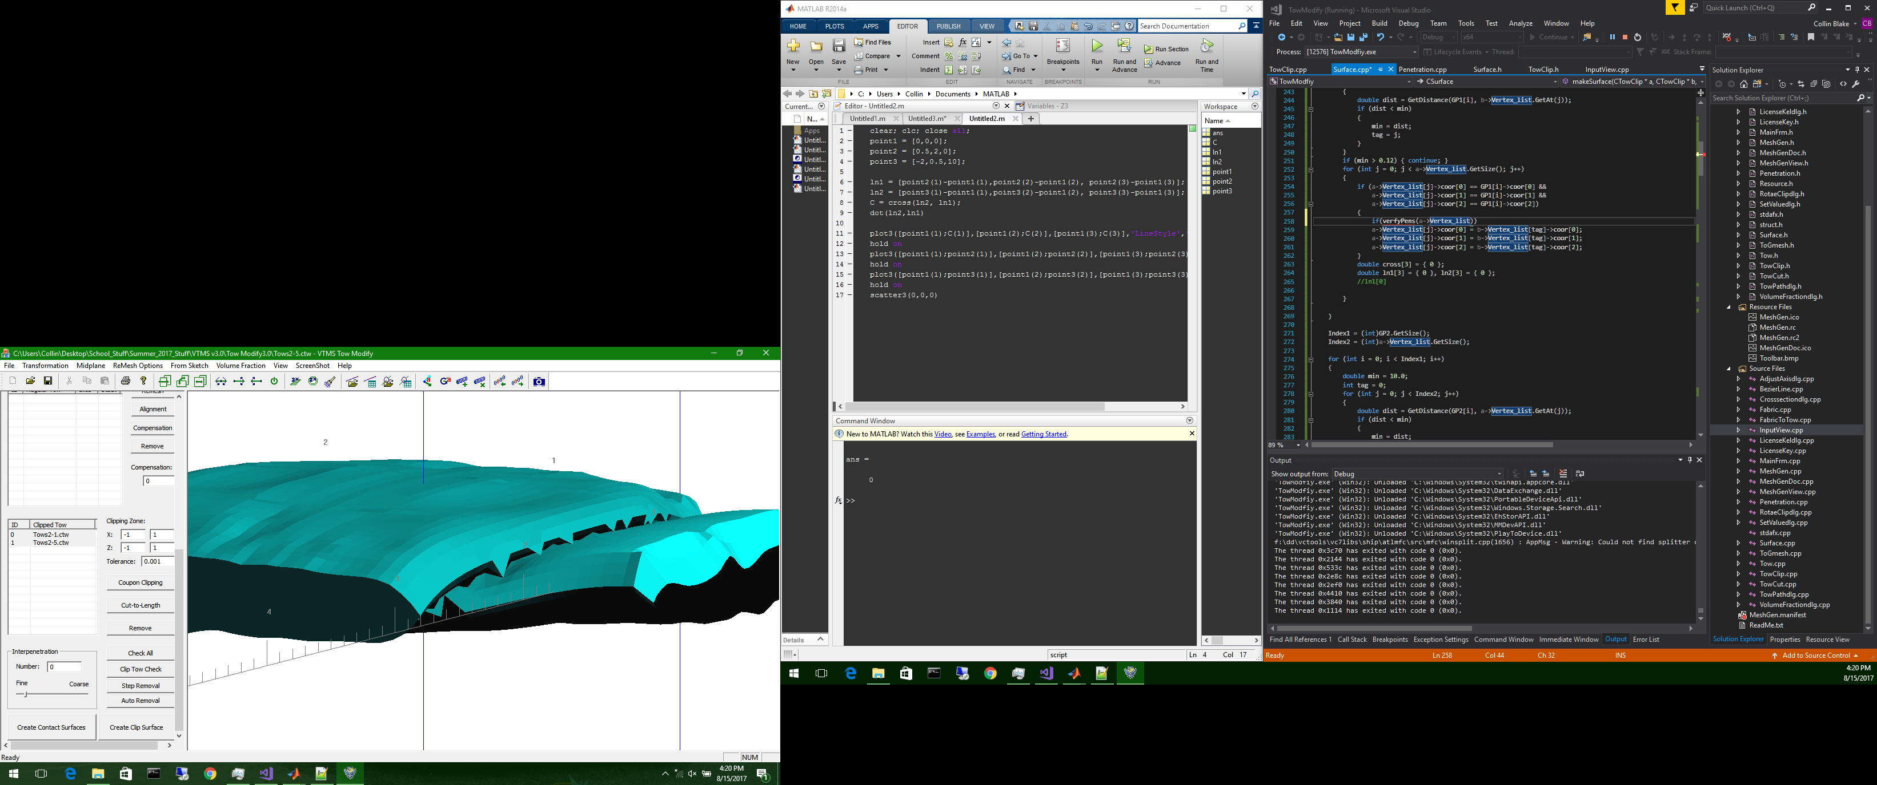
Current Solution (Cont’d)
Known Issues
Degenerate Elements
Nodes allowed to move outside tow boundary
Jagged topography between tows
Possible Solutions
Mesh cleaning to renumber elements and nodes
Improve penetration routines
Correct with smoothening

Slide 13
Future Work
Work on establishing a surface between tows for better surface matching for 3-D wovens
Correct meshes to work more readily with FEA software
Evaluate reduction in tow volumes after surfaces
Work towards a Parallelization of VTMS

Slide 14
Questions?

